Slide 1
Heart Disease Prediction
Project Team ID:- PTID-CDS-JUL-25-2884
Project ID :- PRCP-1016-HeartDieseasePred
Presented By:-
Meet Wani & Deepak Jadhav
Heart disease remains one of the leading causes of death worldwide. Early detection is critical in reducing mortality rates and improving treatment outcomes. In this project, we developed a machine learning model to predict the presence of heart disease using clinical and demographic data. The aim is to support healthcare professionals with a fast, data-driven decision-making tool.

Slide 2
01
Introduction
02
Data Gathering
03
EXPLORATORY DATA ANALYSIS
04
Feature Extraction
05
Methodology
06
Experimental results
07
Conclusion
08
Appendices and references

Slide 3
INTRODUCTION
Heart disease is a major global health issue causing millions of deaths each year.
Early and accurate prediction can significantly reduce the risk and support timely treatment.
Machine Learning (ML) offers data-driven methods to identify patterns in patient data.
This project builds a classification model to predict heart disease presence based on patient records.
It follows a step-by-step ML pipeline from EDA to model evaluation for reliable predictions.

Slide 4
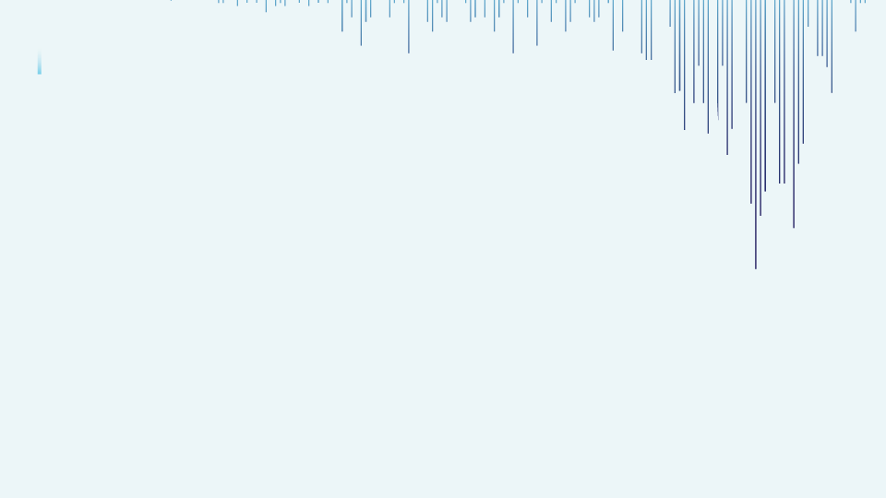


Dashboard Visualization
STEP
Developing an interactive Power BI dashboard to visualize conversion patterns and support business decision-making.
07
Model Evaluation
STEP
Comparing models using metrics such as Accuracy, Precision, Recall, F1-Score, and Confusion Matrix to select the best performer.
06
Model Building
Training multiple machine learning classifiers (Random Forest variants) and fine-tuning hyperparameters.
STEP
05
Feature Engineering
WORK FLOW
WORK FLOW
STEP
04
Creating new features like age groups and applying techniques like SMOTE to address class imbalance.
PREPROCESSING
STEP
Cleaning missing values, encoding categorical variables, and scaling numerical features to prepare the dataset for modeling.
03
Exploratory Data Analysis (EDA)
STEP
02
Analyzing feature distributions and relationships to discover patterns, trends, and potential influencers of conversion.
Data Collection
STEP
Gathering and organizing customer demographics, engagement, and campaign data to train machine learning models.
01

Slide 5
Data Collection
The dataset used in this project was provided by our internship organization. It includes 303 patient records with features such as age, blood pressure, cholesterol levels, chest pain type, heart rate, and more.
The target variable is heart_disease_present:
“0 → No Heart Disease”
“1 → Heart Disease Present”
The data contains both numerical and categorical variables, making it suitable for machine learning classification models.

Slide 6

EXPLORATORY DATA ANALYSIS
Exploratory Data Analysis (EDA) plays a crucial role in understanding the dataset’s structure, relationships, and key patterns before model building. It helps us clean, visualize, and interpret the data in a meaningful way.
1. Univariate Analysis:
For numerical features, we used histograms and KDE plots to examine the distribution, skewness, and spread. This helped identify normal vs skewed distributions and detect outliers.
For categorical features, we plotted bar charts to visualize the frequency of each category and understand class distribution for variables like chest pain type, thal, and fasting blood sugar.
2. Bivariate Analysis:
Numerical vs Target: We used KDE plots and average comparison bars to observe how continuous variables like age, cholesterol, and heart rate differ across heart disease classes (0 and 1).
Categorical vs Target: We used 100% stacked bar plots to compare the proportion of each category within features like chest pain, thal, and exercise-induced angina across the target variable. This helped identify strong predictors.
Overall, EDA revealed important trends, potential feature importance, and areas where data preprocessing was needed (like outliers and skewness), setting a strong foundation for model training.

Slide 7

PREPROCESSSING
1. Null Values:
The dataset was checked for missing values, and no null values were found.
2. Outlier Handling:
Outliers were identified in features like resting blood pressure and serum cholesterol.
As the dataset is small, instead of removing records, we used Box-Cox transformation to reduce the effect of extreme values.
3. Corrupted Data:
We validated each column for invalid entries (e.g., age below 18 or above 100, heart rate above 250), but no corrupted data was found.
4.Categorical Encoding:
Categorical features like chest pain, thal, and resting ECG were converted using One-Hot Encoding to prepare them for machine learning algorithms.
5. Scaling:
Scaling was not applied to tree-based models (like Decision Tree, Random Forest), but used for algorithms like Logistic Regression, KNN, and SVM using Standard Scaler.
6. Class Imbalance:
The target variable was slightly imbalanced. We checked proportions and made sure the train-test split preserved class ratios.

Slide 8
TRAIN TEST SPLIT
To train and evaluate the machine learning models fairly, we split the dataset into training and testing sets.
Key Highlights:
We used an 80:20 ratio to split the data:
80% of the data was used to train the models.
20% was kept aside for final testing to evaluate performance on unseen data.
Stratified Sampling was applied to ensure both training and testing sets had a similar proportion of target classes (0 = No Heart Disease, 1 = Heart Disease Present).
After splitting:
Training Set Class Distribution:
0: 55.5%
1: 44.4%
Testing Set Class Distribution:
0: 55.5%
1: 44.4%

Slide 9
MODEL SELECTION
Models used:
Decision Tree Classifier: A tree-based model that learns simple decision rules. It’s interpretable and fast, but may overfit if not tuned.
Random Forest Classifier: An ensemble of decision trees that reduces overfitting and improves accuracy. It works well with both categorical and numerical data.
Logistic Regression: A statistical model suitable for binary classification. It's efficient, interpretable, and performs well when data is linearly separable.
K-Nearest Neighbors (KNN): A non-parametric model that classifies based on similarity to neighbors. It requires feature scaling and can be sensitive to noisy data.
Support Vector Machine (SVM): A powerful classifier that tries to find the optimal boundary between classes. We used it with scaling and enabled probability estimates.

Slide 10
MODEL Evaluation
1. Logistic Regression gave the best overall performance:
Highest Recall (1.00) – it detected all positive heart disease cases, which is very important in healthcare.
Also had the highest Accuracy (88.88%) and ROC-AUC (0.9375), showing strong and reliable predictions.
2. KNN and Random Forest both performed very well:
High Recall (0.9375) and F1-Score (0.8571) — making them good choices for detecting heart disease with few false negatives.
Slightly lower Accuracy than Logistic Regression.
3. SVM showed decent performance:
Good balance between all metrics, especially ROC-AUC (0.9281), meaning it’s good at distinguishing between classes.
4. Decision Tree had the lowest performance among all:
Accuracy (80.55%) and F1-Score (0.78) are lower compared to other models.
Still usable, but not the best choice for this task.
Logistic Regression is the best overall model due to perfect recall and strong performance across all metrics, making it ideal for a sensitive health prediction task.

Slide 11

Conclusion
Conclusion
We successfully developed a heart disease prediction system using multiple machine learning models. The aim was to detect heart disease early with high accuracy and reliability.
Key Points:
After testing 5 models, Logistic Regression showed the best performance with:
Accuracy: 88.89%
Recall: 100% (no heart disease case was missed)
ROC-AUC: 93.75%
KNN and Random Forest also gave high recall and balanced scores.
Decision Tree and SVM performed slightly lower but were still acceptable.
Logistic Regression was chosen as the final model for its high recall, simplicity, and good interpretability—making it suitable for real-world healthcare use.

Slide 12
Appendices and references
Appendices
Dataset: Provided by internship team, includes health indicators and heart disease label.
Tools Used: Python (Pandas, NumPy, Sklearn, Seaborn, Matplotlib), Jupyter Notebook.
Key Techniques: Outlier handling, feature selection, SMOTE, one-hot encoding, scaling.
Evaluation Metrics: Accuracy, Precision, Recall, F1-Score, ROC-AUC.
References
Scikit-learn Documentation
Python Data Science Handbook

Slide 13



